Slide 1
Crowd Code
Aiden Cohen, Akshay Joshi, Geoffrey Xue, Michael Noguera
Notes:
For our Hatathon project, we created Crowd Code. Crowd Code is a testing framework for the education community: students and instructors can use Crowd Code to make the process of programming more transparent and interactive.

Slide 2
What is Crowd Code?
Code testing framework
Web-based
Collaborative: crowdsourced test cases
Notes:
Our common experience as cs students…
Programming projects common, setup of development environment is complicated, and using the Same interface – desired or required
Crowd Code allows anybody to log in and upload a test case and
provides a convenient way to run the online test cases against your implementation of a program.
So what do we mean by this?

Slide 3
Integration/E2E Testing
Notes:
Integration, or “End to End” testing looks at a program as a whole, and checks that it gives the expected outputs for each known input. This differs from Unit Testing, which tests the functioning of each separable part of a program.
With integration testing, you don’t need to interact with the code base of the application you test, only the exposed interfaces.
In this case, because our test runner can’t see inside the application, this is a form of “black box” testing as well.
This is important for Crowd Code’s usage by students, because while the program spec for an assignment is usually public (instructors want everyone’s implementations to match the same interface), there are often restrictions on sharing code. We chose the “End to End” approach specifically for this reason.

Slide 4
Integration/E2E Testing
Notes:
Integration, or “End to End” testing looks at a program as a whole, and checks that it gives the expected outputs for each known input. This differs from Unit Testing, which tests the functioning of each separable part of a program.
With integration testing, you don’t need to interact with the code base of the application you test, only the exposed interfaces.
In this case, because our test runner can’t see inside the application, this is a form of “black box” testing as well.
This is important for Crowd Code’s usage by students, because while the program spec for an assignment is usually public (instructors want everyone’s implementations to match the same interface), there are often restrictions on sharing code. We chose the “End to End” approach specifically for this reason.

Slide 5
Notes:
So this diagram nu

Slide 6
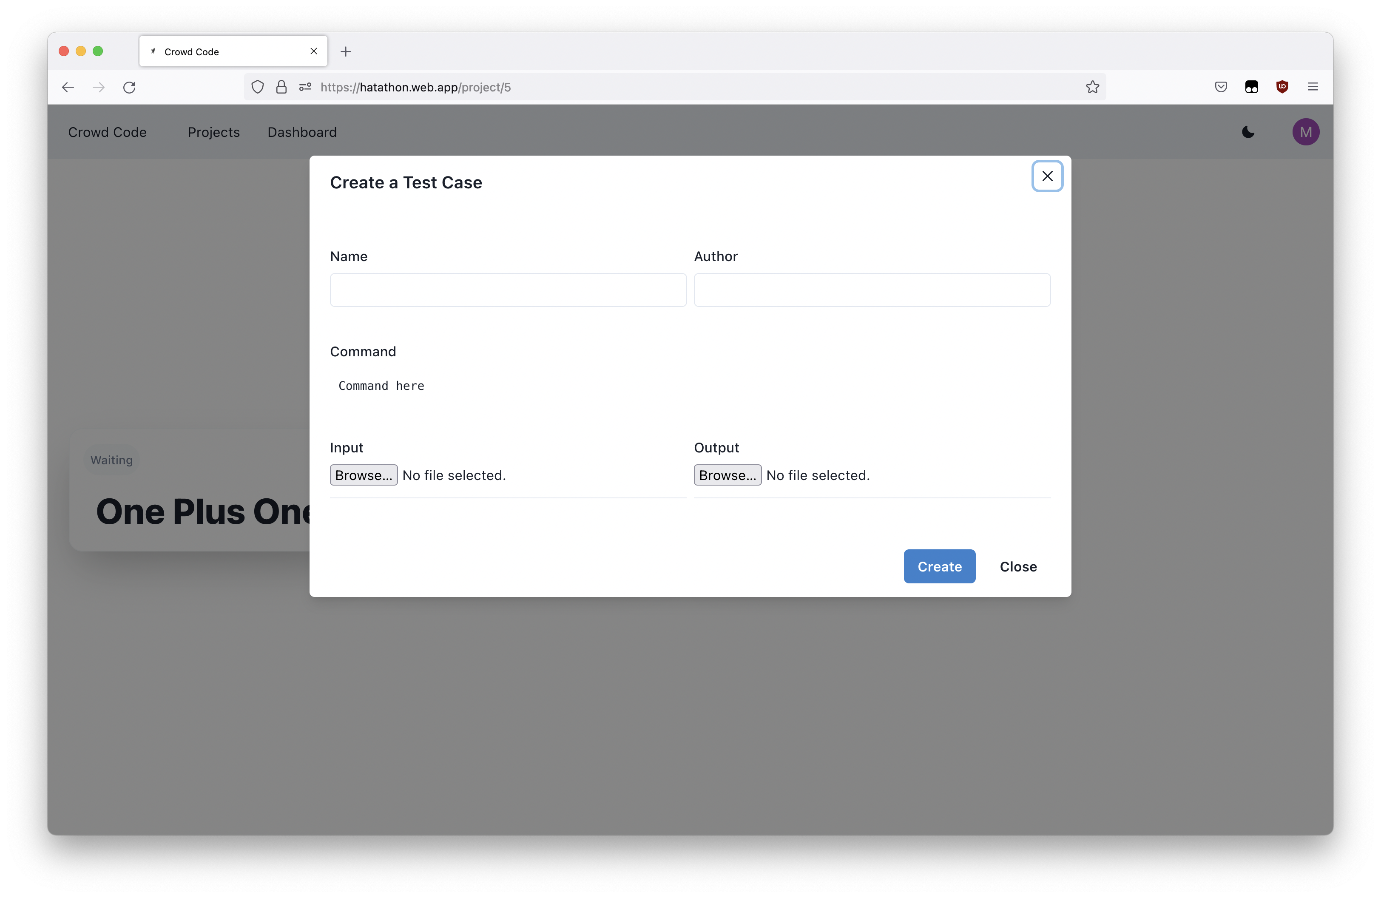

Slide 7
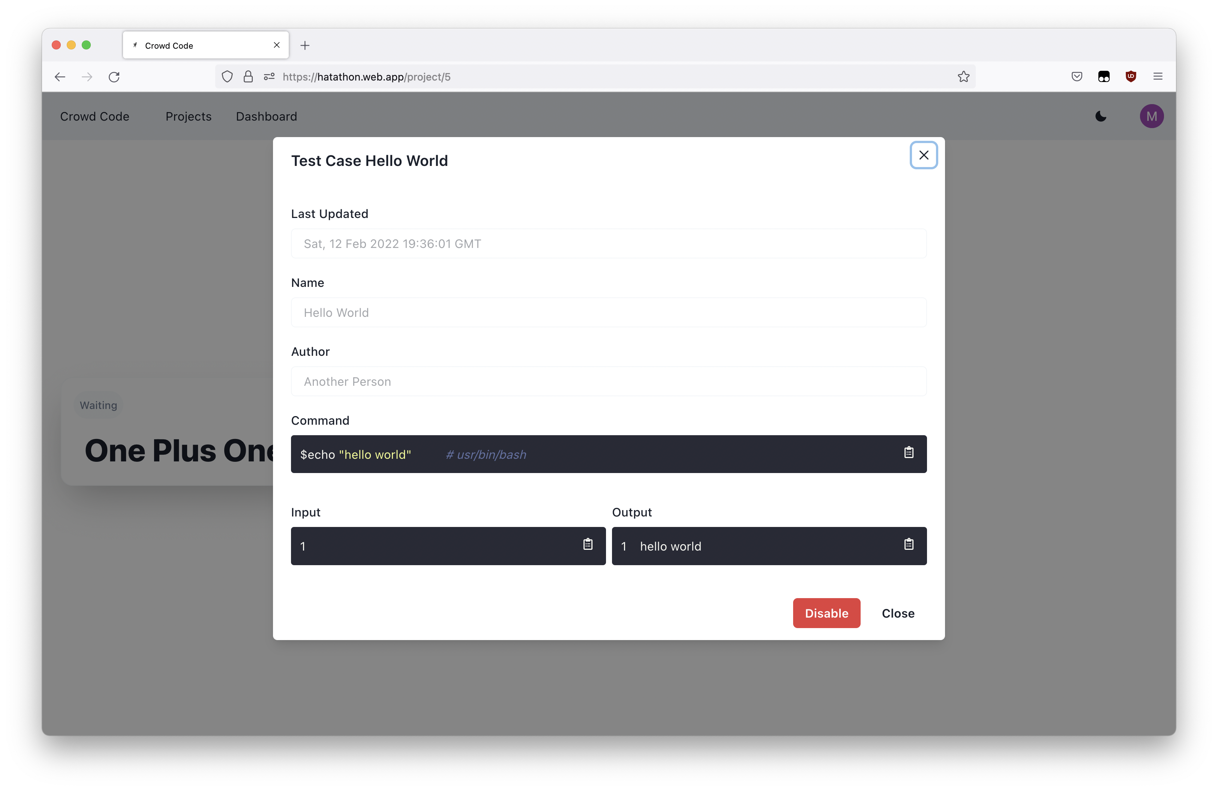

Slide 8
(oauth)
file store containing input/output
Notes:
The way that Crowd Code works is that users navigate to our web page in their browser and sign in.
They can create projects and add test cases

Slide 9
file store containing input/output
Notes:
The way that Crowd Code works is that users navigate to our web page in their browser and sign in.
They can create projects and add test cases

Slide 10
(oauth)
Notes:
The way that Crowd Code works is that users navigate to our web page in their browser and sign in.
They can create projects and add test cases

Slide 11
(oauth)
file store containing input/output
Notes:
The way that Crowd Code works is that users navigate to our web page in their browser and sign in.
They can create projects and add test cases

Slide 12
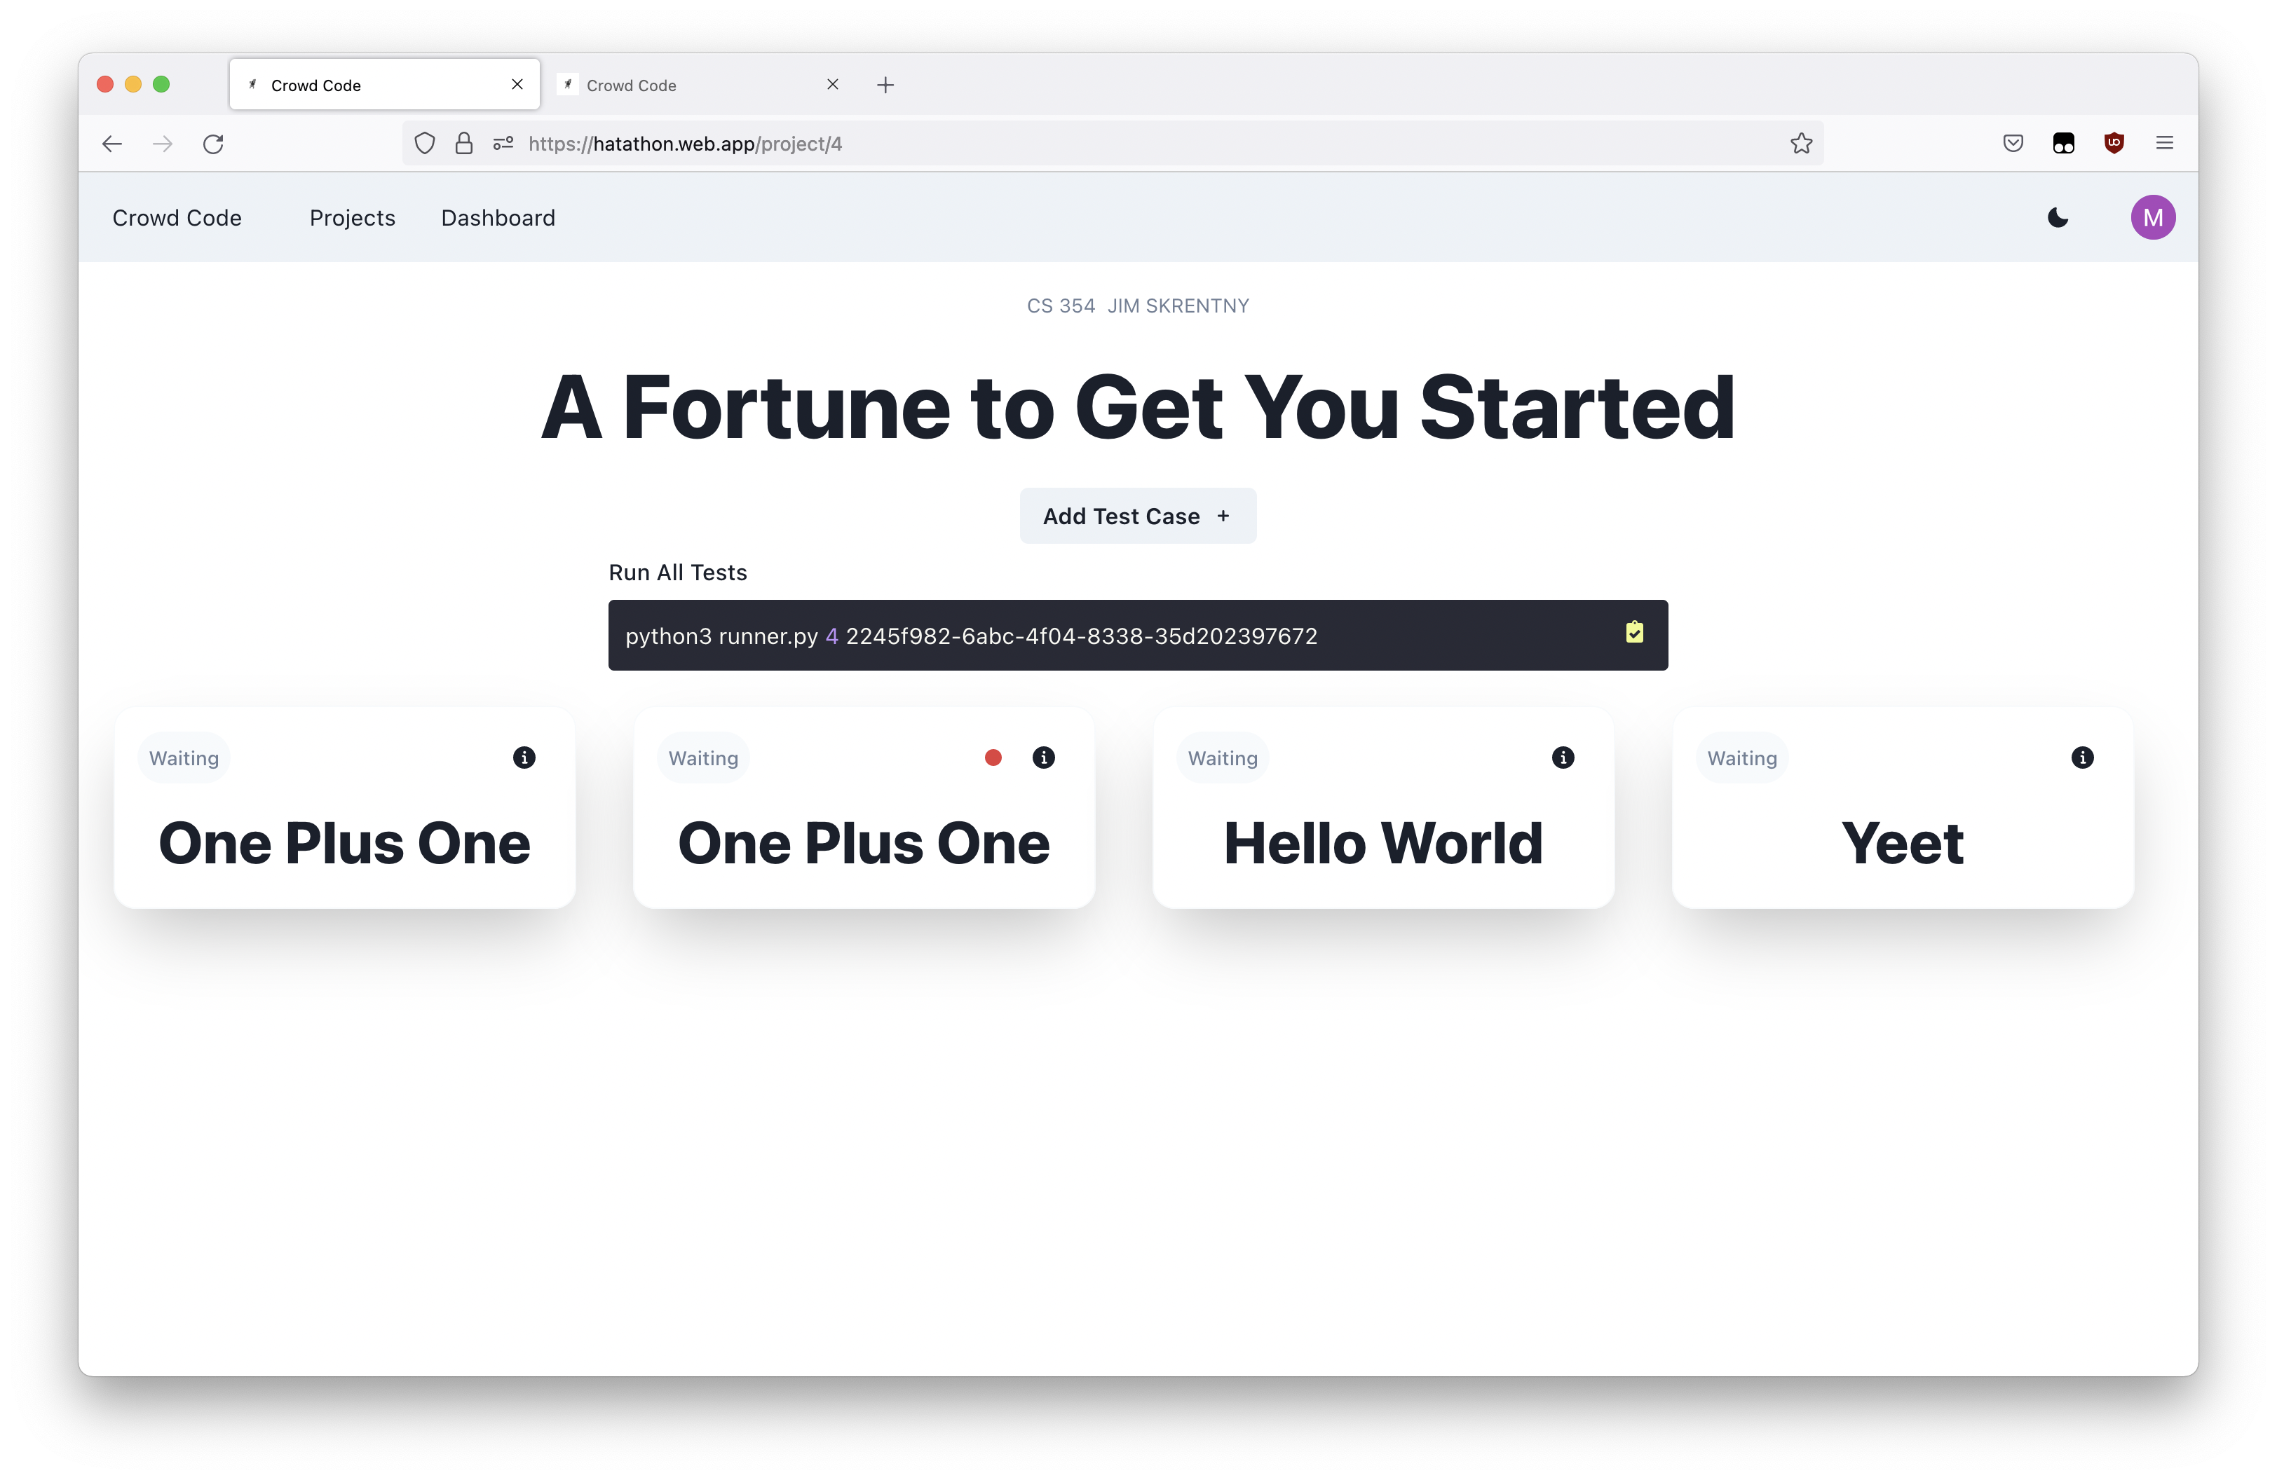

Slide 13
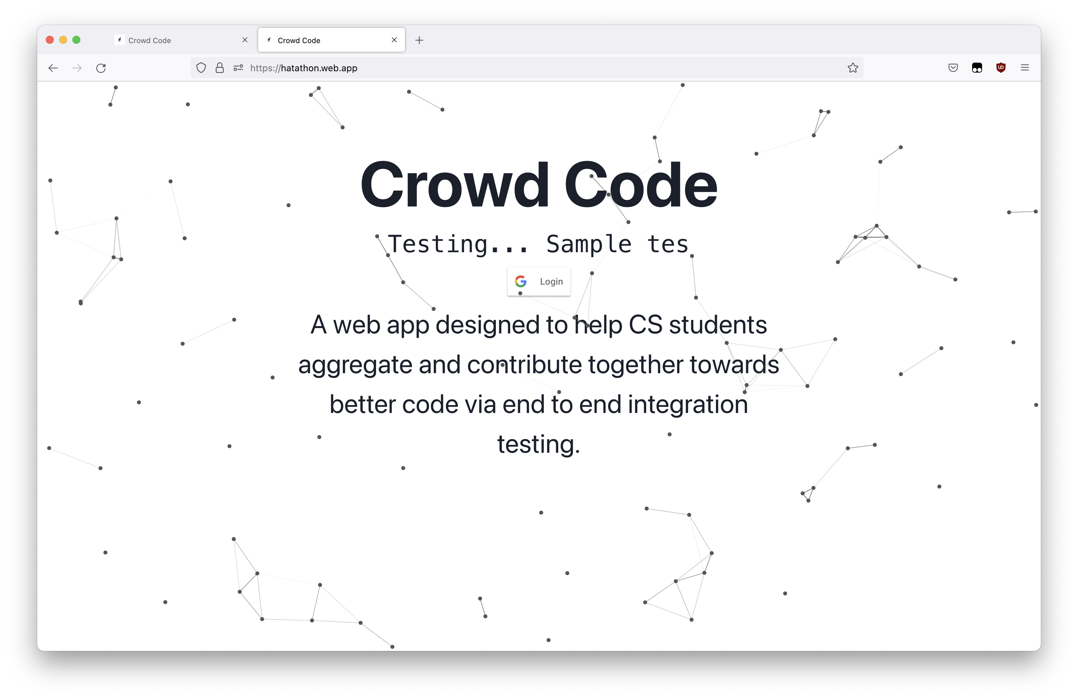

Slide 14
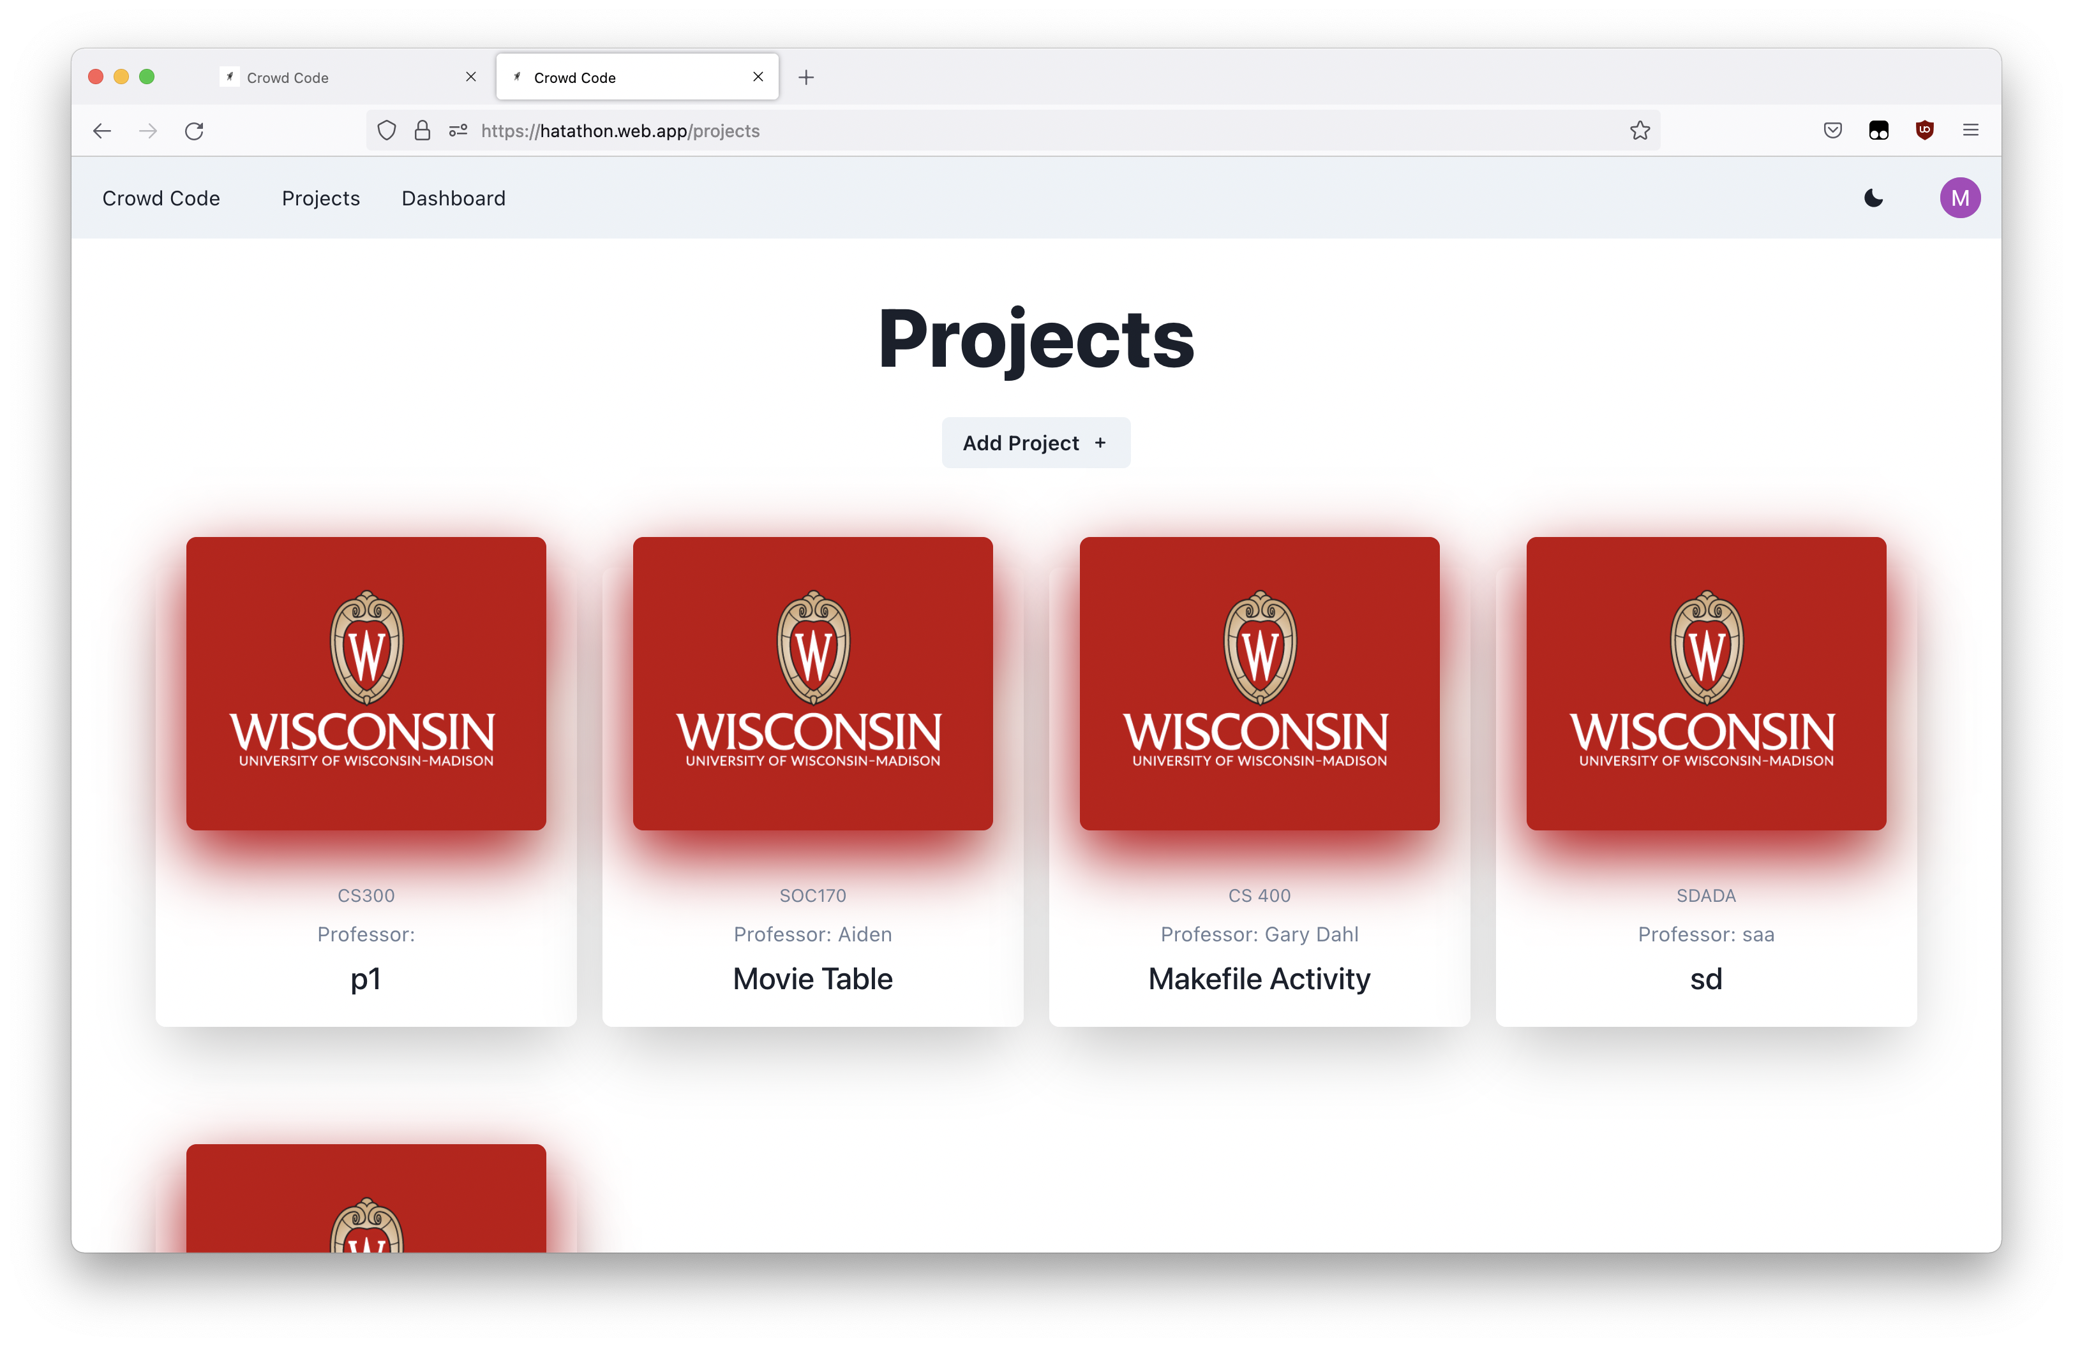

Slide 15
Demo

Slide 16
Next Steps
Sandboxing
User types: Professors & TAs vs. Students
Notes:
We’ve given some thought to what our next steps could be.

